Slide 1


Practice Assessment
Sharvesh Subhash,
Latentview Analytics
Task 6 to Task 9

Slide 2
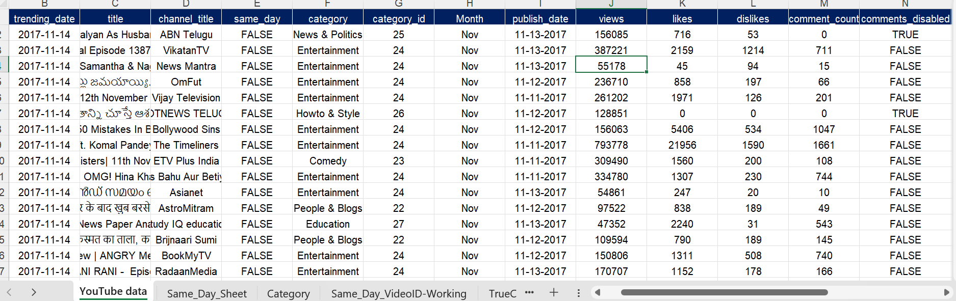
TASK 1
Formatted data properly as per steps prescribed:

Slide 3
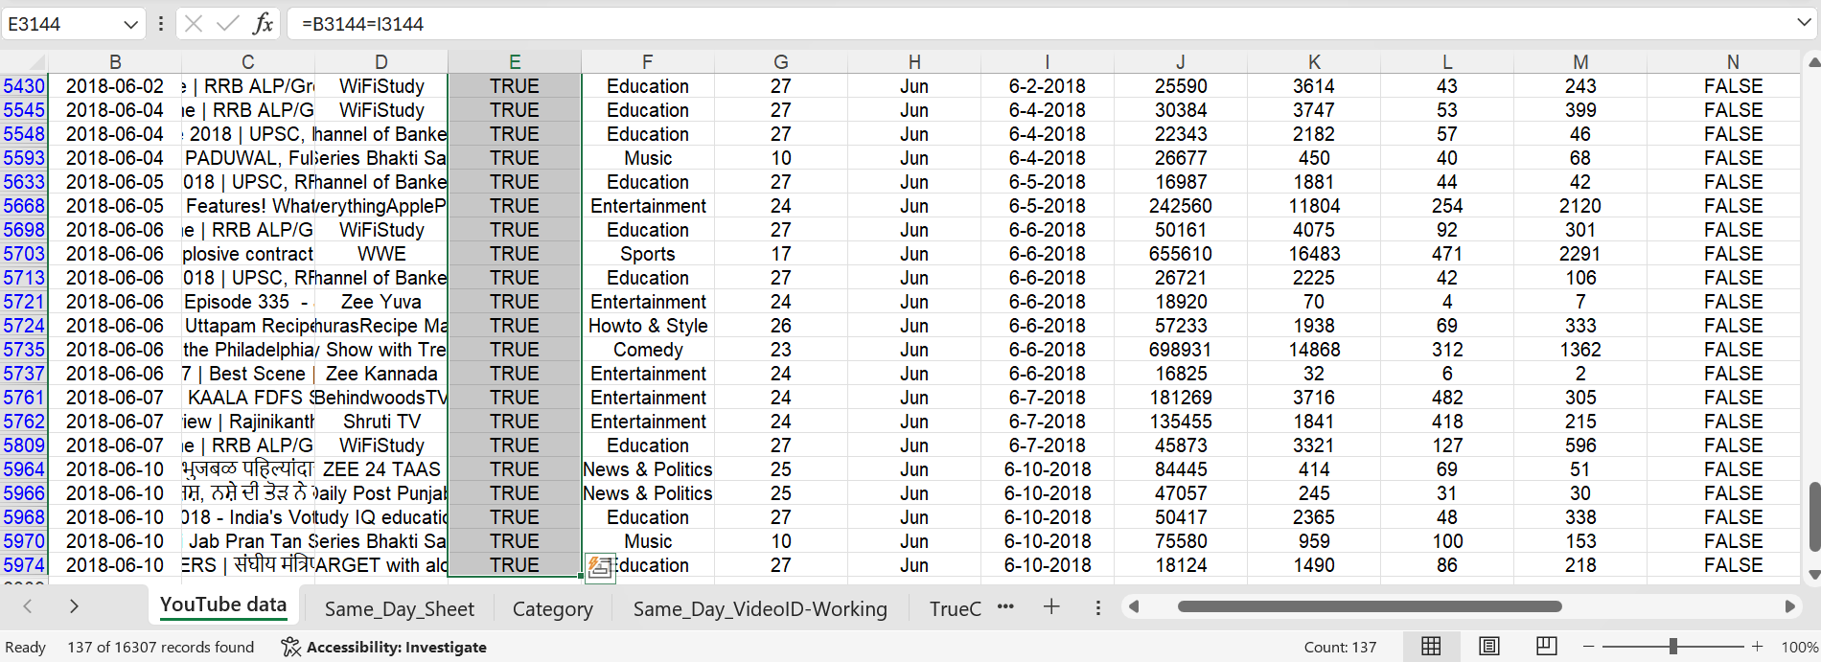
TASK 2
Counted the Videos that were trending on the same day, count: 137

Slide 4
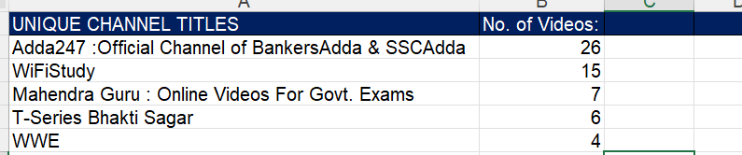
TASK 3
Found the Top 3 Channel names with the most same day trending videos:
Shockingly, the same day trending videos count
are from these top three channels.

Slide 5
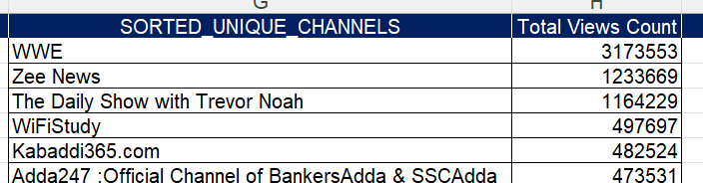
TASK 4
Top 3 Channel names and their view count:
On the same day, WWE, ZEE News and The Daily Show with
Trevor Noah(when it used to be) have had the top 3 views count.

Slide 6
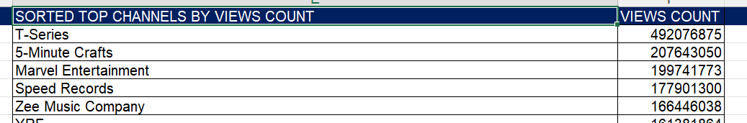
TASK 5
Top 3 Channels with the most sum of views:
T-Series, 5-minute craft, and Marvel Entertainment have got the top 3 viewership in YouTube.

Slide 7
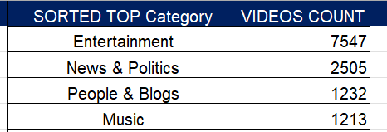
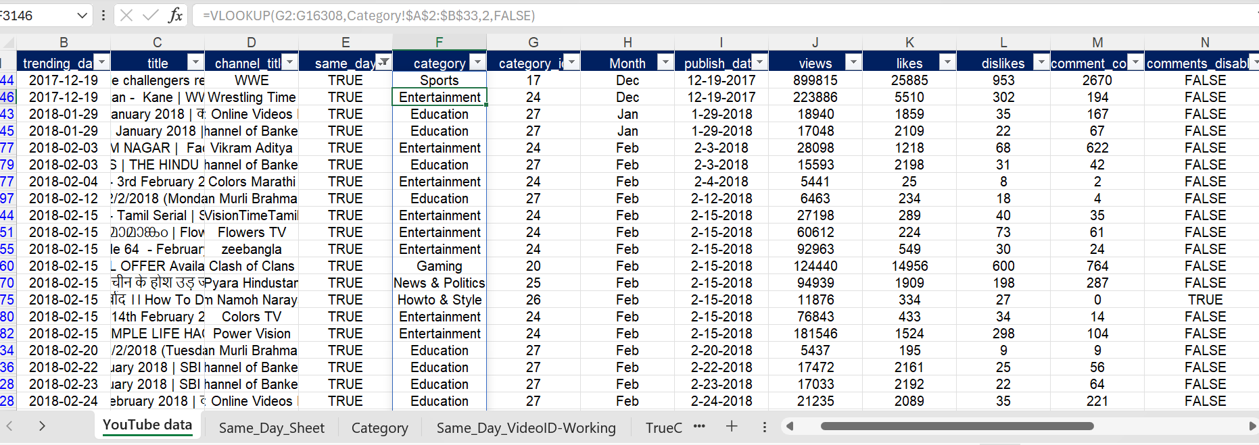
TASK 6
TOP 3 Categories with maximum number of videos, along with creation of categories column in original dataset
Entertainment category has become the undisputed king

Slide 8
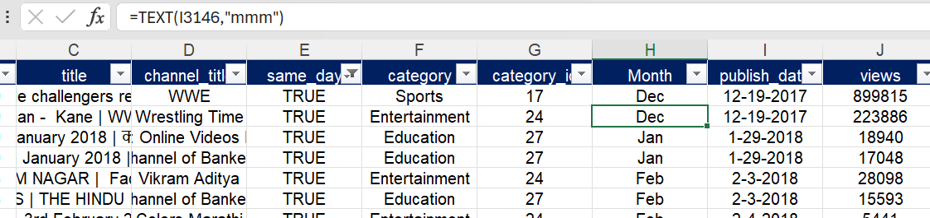
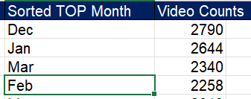
TASK 7
Top 3 months with maximum number of videos along with creation of new column month
December, January and March have had the highest number of video
publishing.

Slide 9
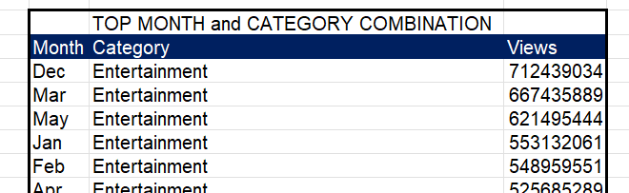
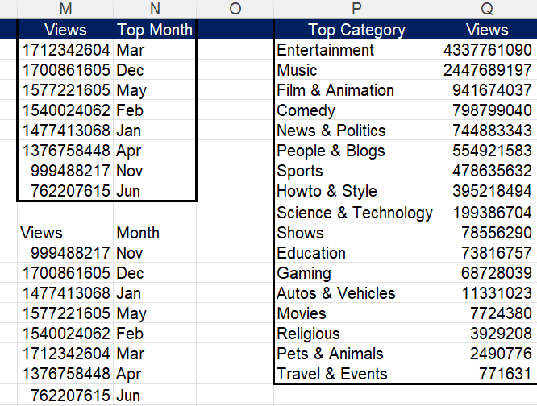
TASK 8
The category and month combination with the highest views:
Highest views in month and category separately
Best time to make an entertainment video in YouTube
will be during the month of December (due to its holiday season).
In general, entertainment category-based videos can easily
raise a channel’s viewership. And the month of March is good
for any type of video, in terms of increasing viewership.
Further analysis needed.

Slide 10
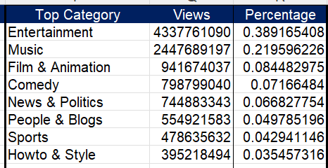
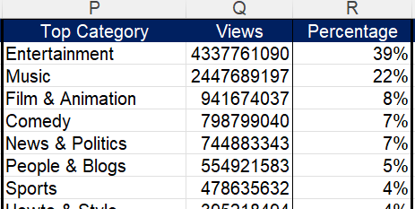

TASK 9
TOP 3 Categories with the highest percentage of views
Entertainment category has a whopping 39% viewership

Slide 11
